Slide 1
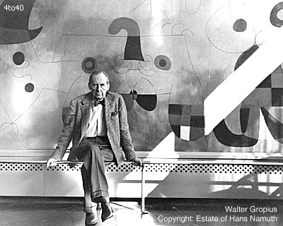
WALTER GROPIUS
by R.MONIKA

Slide 2
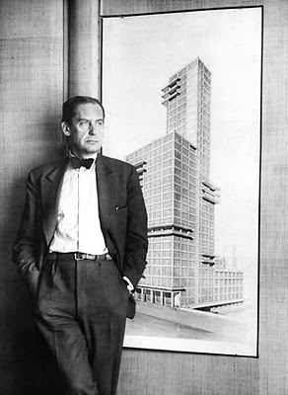
GENERAL INFORMATION GENERAL INFORMATION
WALTER GROPIUS FULL NAME-GEORGE WALTER ADOLF GROPIUS.
BORN IN BERLIN ON 18 MAY 1883
WAS A GERMAN AMERICAN ARCHITECT AND EDUCATOR.
HE WAS AN INFLUTENTIAL OF MODERN DESIGN AND FURTHERED HIS IDEAS THROUGH BAUHAUS AND SCHOOL DESIGN,THROUGH HIS OWN ARCHITECTURAL WORKS AND HIS LONG YEARS OF TEACHING AT HARVARD.
HE WAS TAUGHT BY HIS FATHER,HE ALSO WAS AN ARCHITECT AND LEARNED THE STUDY OF PROPORTIONS WITH ACTUAL ARCHITECTURAL EXPRESSIONS BY HIS UNCLE.

Slide 3
HE TOOK 7 MONTHS STUDY IN SPAIN AND MET PETER BEHERNS IN 1908 AND WORKED UNDER HIM.
IN 1934,HE MOVED TO U.K.LONDON,WHERE HE WAS THE CONTROLLER OF DESIGN.
IN 1937,HE DEPARTED LONDON FOR NEW YORK AND HARVARD UNIVERSITY.
AT AN AGE WHEN MOST MET RETIRE,GROPIUS DESIGN BEGAN HIS CARRIER IN FULL VITALITY AND ENTHUSIASIM.UNFORTUNATELY,ARCH COMMISIONS DID NOT MATCH WITH THAT ENTHUSIASIM.

Slide 4
PSYCHOLOGY OF HIS THOUGHTS
GROPIUS WAS NOT ONLY AN ARCHITECT BUT AN EDUCATOR TOO,HIS PSYCHOLOGY WAS INFLUENCED BY THE CONSTANT SOURCE OF LEARNING AND IMPARTING THAT KNOWLEDGE ABOUT HIMSELF.
HI S INSTRUCTIONAL METHODS WERE DIFFERENT IN THE TEACHING AT HARVARD UNIVERSITY.
HIS DESIGN HAS FULL COMMAND OF THE ELEMENTS OF ARCHITECTURE,WHICH WERE TO CONSTITUTE THE INTERNATIONAL MODERN STYLE, THAT IS GLASS CURTAIN WALLS,UNRELEVANT TO BE BIG BLOCK AND CORNER LEFT FREE OF VISIBLE SUPPORTS.
HE BELIEVED THAT ALL ARTIST MUST BE FAMILIAR WITH THE CRAFTS AND INIIAL TRAINING FOR ARTIST AND CRAFTMAN SHOULD BE SAME i.e. INRODUCTION TO FORM,COLOUR NATURE OF MATERIAL.

Slide 5
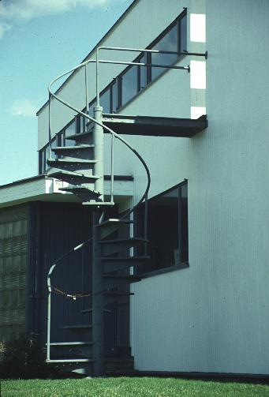
HIS PROGRAMME WAS WRITTEN TO ENCOURAGE COLLABORATIVE EFFORTS WITH LANDSCAPE ARCHITECTURE AND PLANNING DEPTT. THROUGH ORGANANISATION BY STUDENTS THEMSELVES.
IN THOSE TIMES THE USE OF WAS ENCOURAGED BECAUSE OF THE PHASE OF INDUSTRILASATION.
HE REALIZED THE INDERDEPENDENCE OF MACHINE AND ARCHITECTURE,THUS ENCOURAGED THE USE OF PREFABRICATED UNITS.
IN HIS BELIEF PRE-FABRICATION IS A LOGICAL PROGRESSIVE PROCESS AIMED AT RISING STANDARD OF BUILDING.

Slide 6
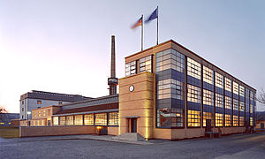
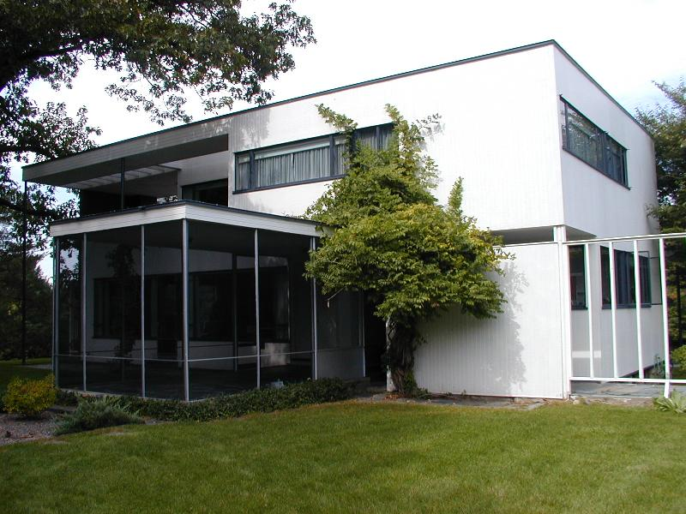
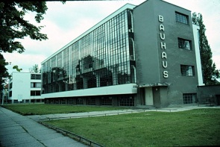
GROPIUS FAMOUS BUILDING
FAGUS FACTORY GROPIUS HOUSE
BAUHAUS DESIGN SCHOOL

Slide 7
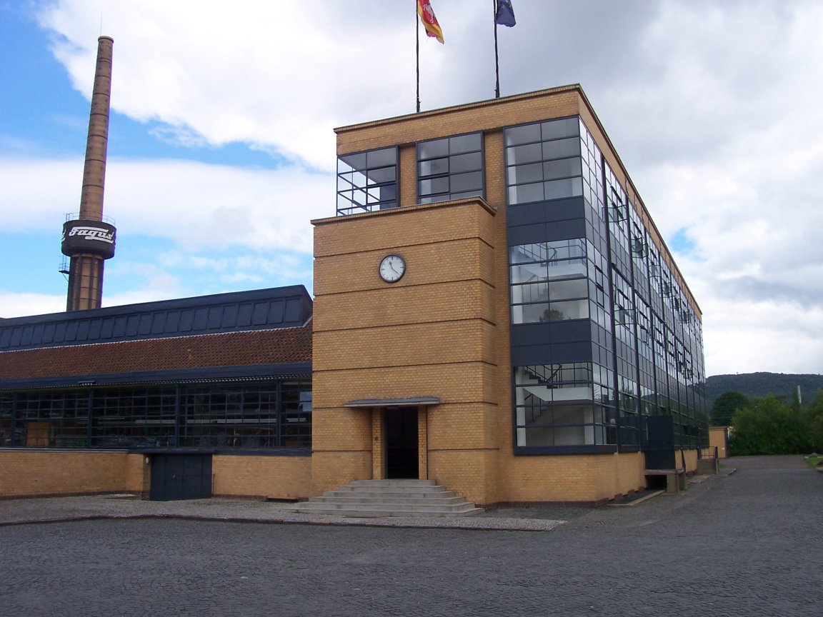
FAGUS FACTORY Alfeld an der Leine,Lower Saxony,Germany
THE FAGUS FACTORY WAS IS TODAY CONSIDERED AS ONE OF THE MOST IMPORTANT INDUSTRIAL STRUCTURES OF MODERN ARCHITECTURE.IT IS CONSIDERED AS A BLUE-PRINT OF THE FUNCTIONAL DESIGN STYLE THAT LATER BECAME LATER ASSOCIATED WITH THE BAUHAUS.

Slide 8
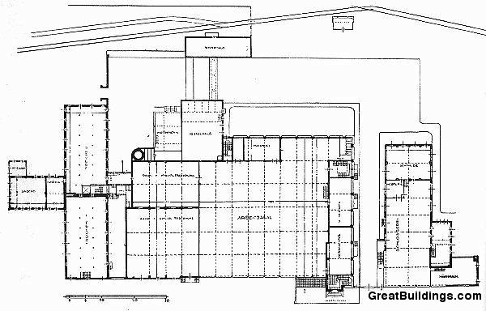
PLAN

Slide 9
IT WAS BUILT AT ALFLED-AN-DER-LEINE IN 1911.
IT WAS IN COLLABORATION WITH ADOLF MEYER.
IT WAS HIS FIRST INDEPENDENT COMMISSION.
MOST STRIKING THING: SIMPLICITY AND CONFIDENCE OF THE ARCHITECTURE.
IN FAGUS WORKS, GROPIUS BROUGHT THE ACCOMPLSHMENT OF THE PAST FIFTEEN YEARS.
IT WAS DESIGNED BY GROPIUS KEEPING IN MIND THE SURROUNDINGS.
IT WAS CALLED BY GROPIUS AN ARTISTIC AND PRACTICAL DESIGN.
FAGUS BUILDING WAS THE FIRST EXTRACT THE FULL AESTHETICALLY REVOLUTINARY IMPACT FROM THE STRUCTURAL DEVELOPMENT
FAGUS STRUCTURE WAS ACTUALLY A HYBRID CONSTRUCTION OF BRICK COLUMNS STEEL BEAMS AND CONCRETE FLOOR SLABS AND STAIRWAYS.
IT WAS STEEL FRAME SUPPORTING THE FLOORS,GLASS SCREEN EXTERNAL WALLS.
PILLARS ARE SET BEHIND THE FAÇADE SO THAT ITS CURTAIN CHARACTER IS FULLY REALIZED.

Slide 10
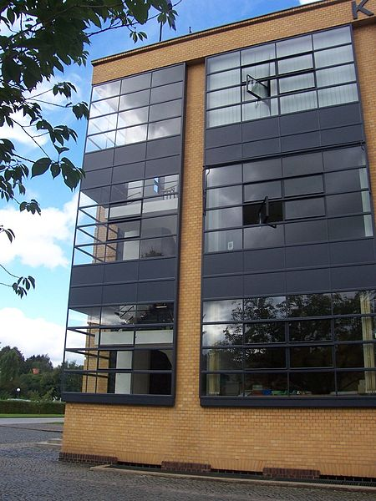
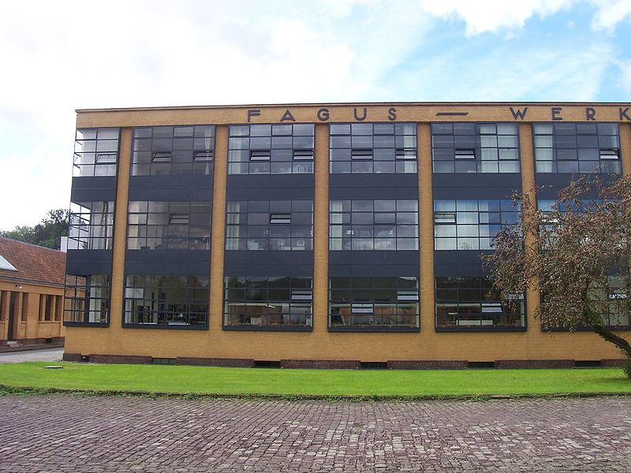
GLASS SCREEN WAS USED ALL OVER THE WALLS TO HAVE PROPER VIEW FROM INSIDE.
WALLS ARE NO LONGER SUPPORTERS OF THE BUILDING BUT SIMPLE CURTAIN PROJECTING AGAINST INCREMENT WEATHER.
IT WAS DOMINATION OF VOIDS OVER SOLIDS.
PLANE SURFACES PREDOMINATE IN THIS FACTORY.
THE GLASS AND WALLS ARE JOINED CLEANELY AT THE CORNERS WITHOUT THE INTERVENTION OF PIERS.

Slide 11
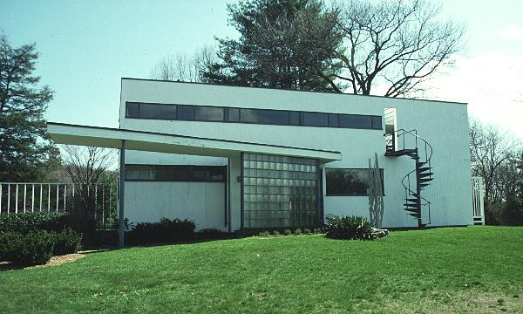
GROPIUS HOUSE,LINCLON,MASSACHUSETTS
IT WAS DONE IN PATRNERSHIP WITH MARCEL BRELLER IN LINCLON(1937-38)
THERE WAS AN EXTENSIVE USE OF TIMBER REINFORCED WITH SOME STEEL MEMBERS,LENDS A DIFFERENT AND SOFTER CHARACTER TO THE BUILDING.
TIMBER CLADDING WAS HUNG VERTICALLY.
INCONSISTENT USE OF ELEMENTS LIKE SPIRAL STAIR TO ROOF TERRACE AND SUN LOUNGE.
THE PLAN WAS WITHOUT CORRIDORS AND ESSENTIALLY A COMPACT,FUNCTIONAL SOLUTION TO THE REQUIRMENTS OF MODERN HOUSE PLANNING.

Slide 12
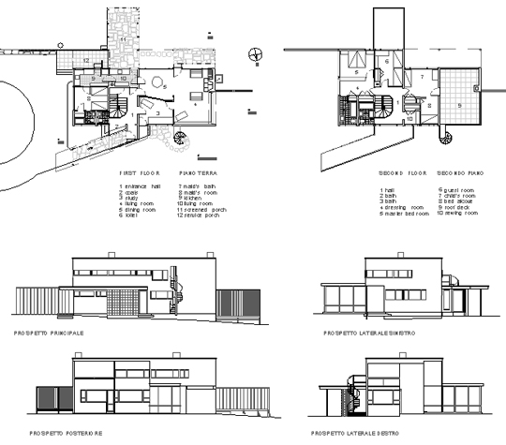
GROPIUS HOUSE PLAN

Slide 13
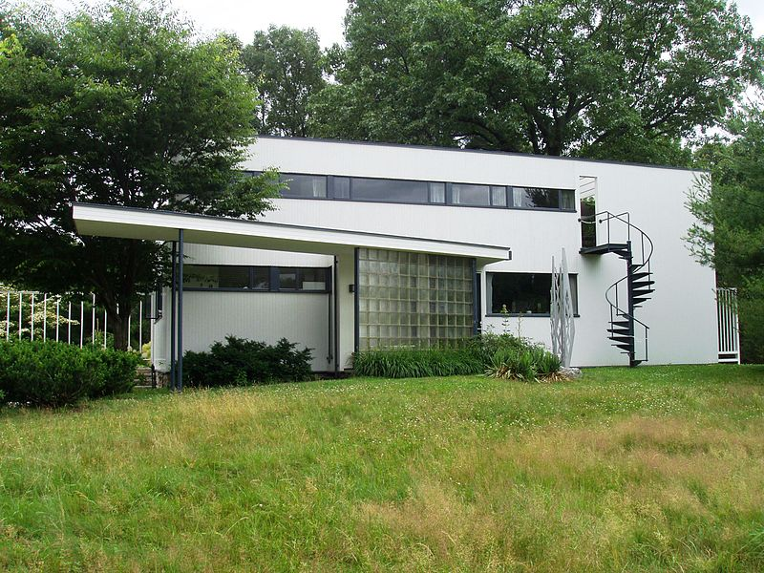
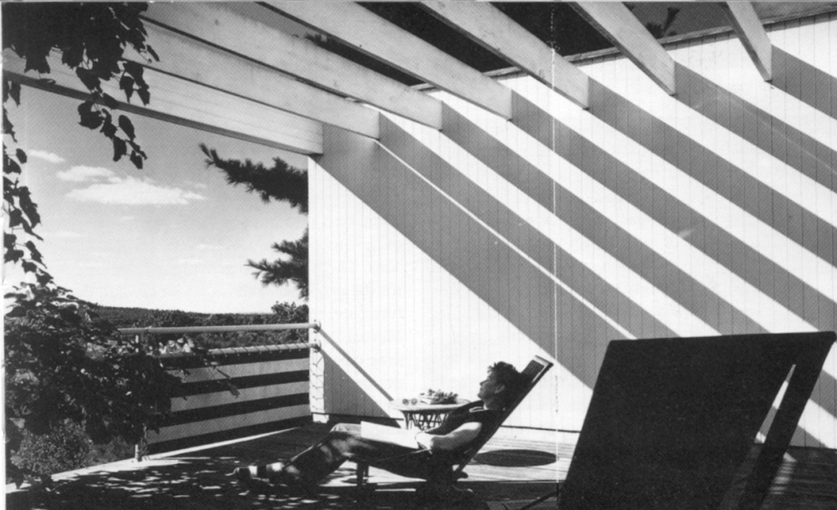
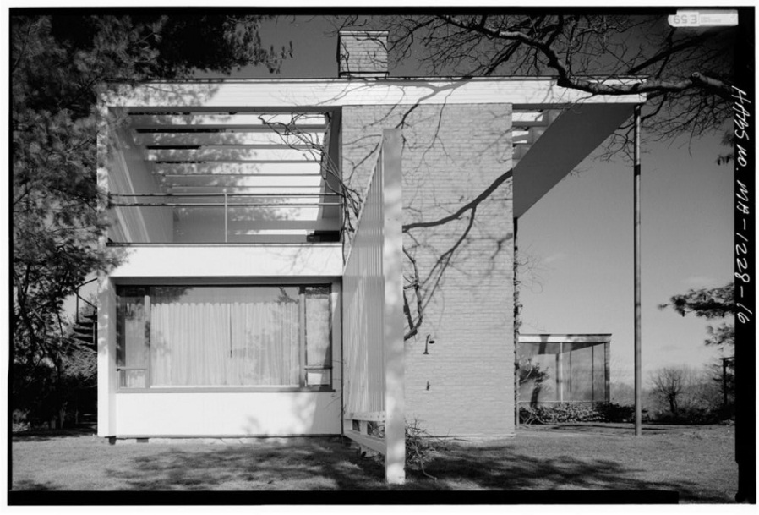
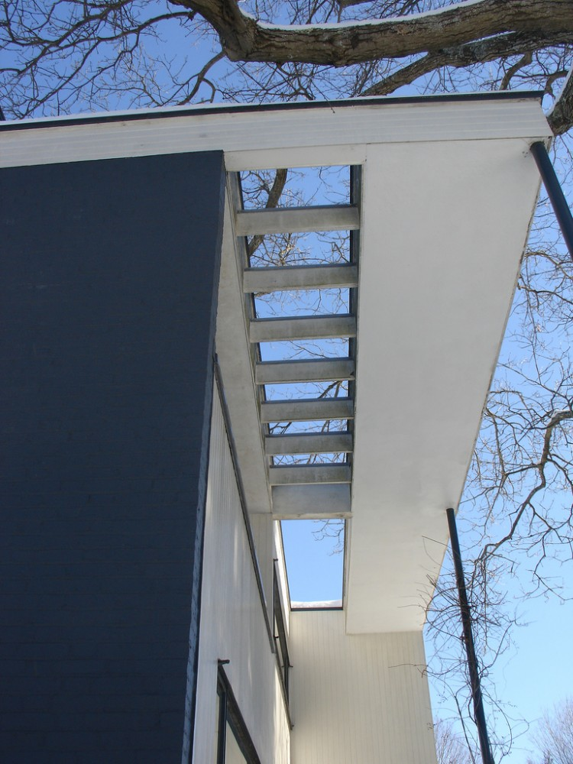
GROPIUS HOUSE EXTERIOR VIEW

Slide 14
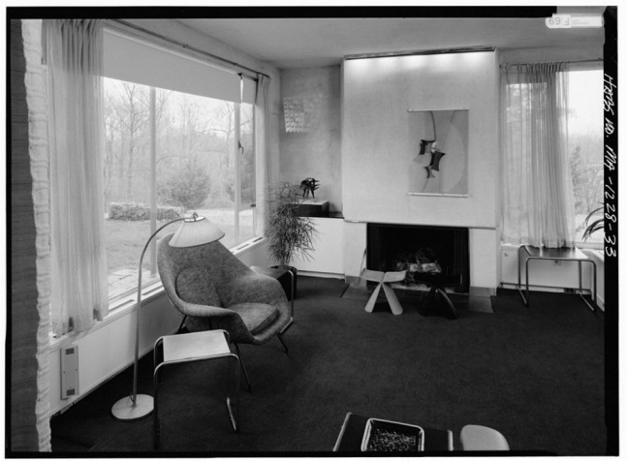
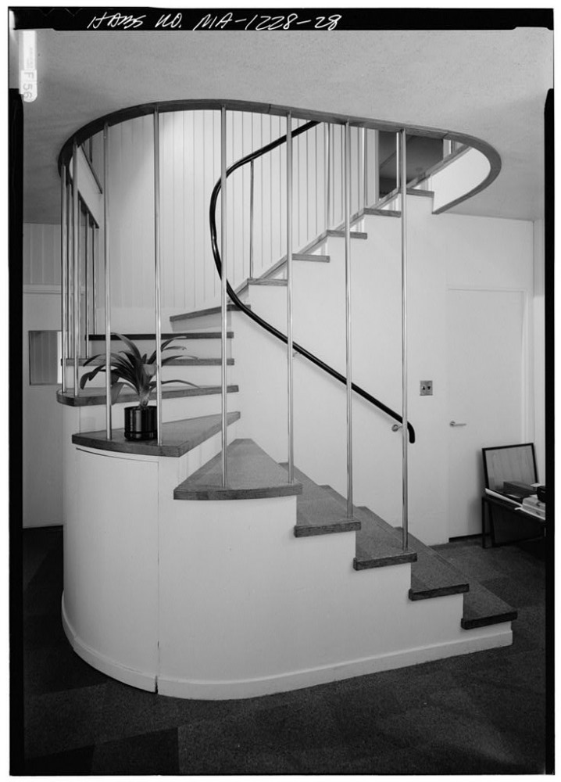
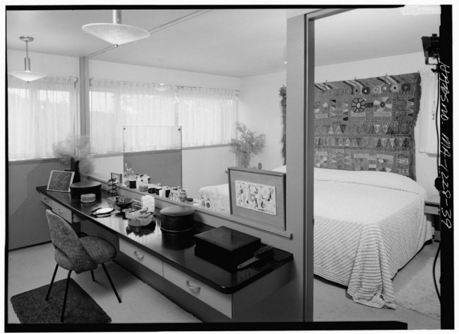
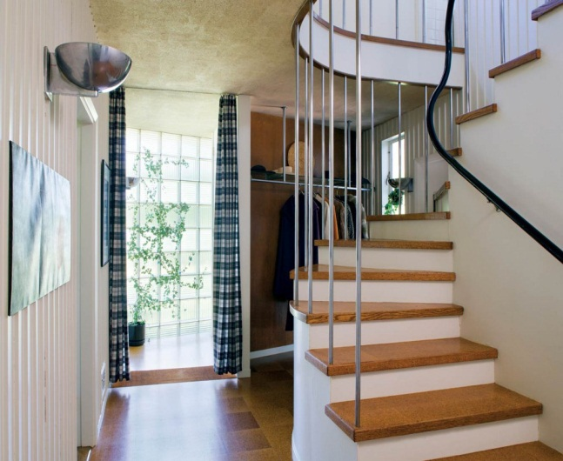
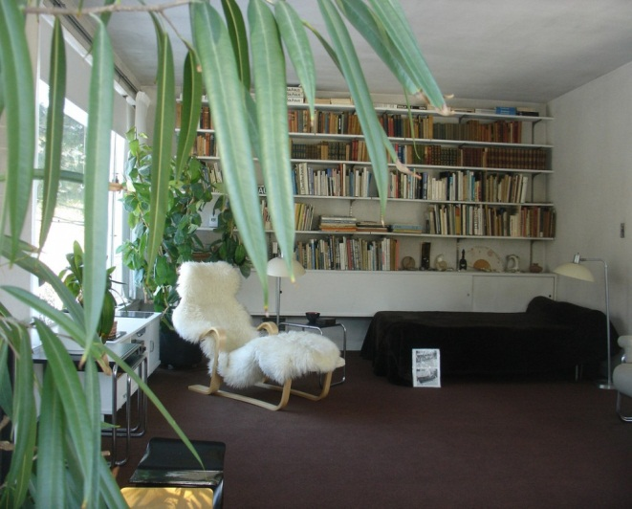
GROPIUS HOUSE INTERIOR VIEW

Slide 15
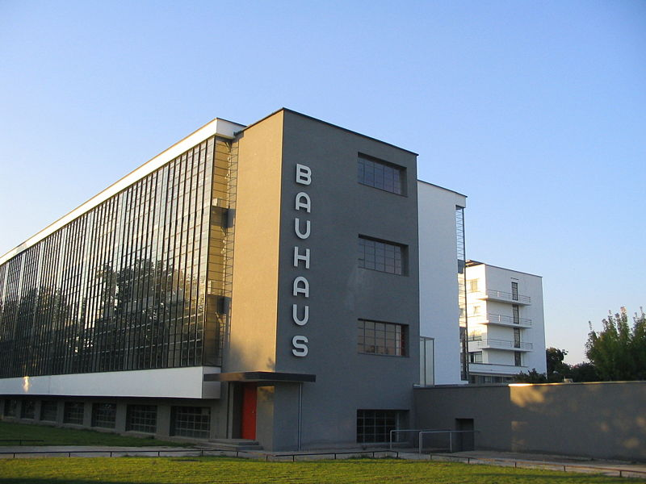
BAUHAS,DESSAU,GERMANY

Slide 16
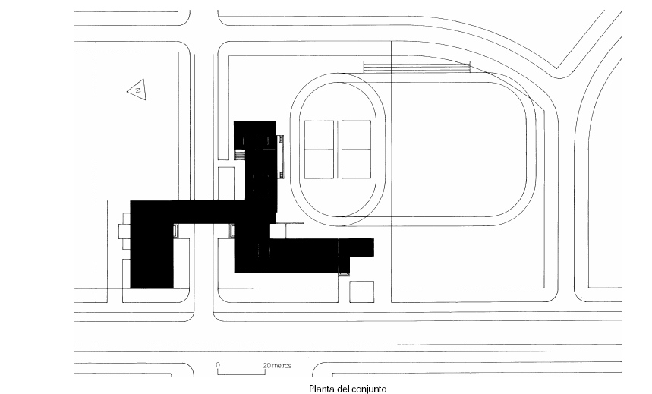
BAUHAS,DESSAU,GERMANY
DESIGNED BY GROPIUS AND HIS PARTNER MEYER WITH CERTAIN AMOUNT OF PARTICIPATION FROM STUDENTS.
THE COMPLEX CONSISTS OF FIVE MAIN ELEMENTS FULLY GLAZED 3 STOREYED:
WORKSHOP BLOCK
TEACHING BLOCK
SOCIAL AREAS
A5-STOREYED STUDY BLOCK
AN ADMINISTRATIVE WING SPANNING THE ROADWAY
TO PRODUCE A SEPARATION OF EACH OF THESE FUNCTIONS FROM OTHERS, AT THE SAME TIME NOT ISOLATING THEM BUT BRINGING THEM TOGETHER INTO EFFICIENT INTEGRATION.
WORK SHOPS NOTICEABLY MODE INDUSTRIAL,PARTICULARLY IN THEIR WINDOW.

Slide 17
THE SQUARE PENALLED METAL WINDOWS ARE TYPICAL OF MASS PRODUCED INDUSTRIAL UNITS.
AESTHETICALLY BAUHAS WAS AN ADVANCED BUILDING BUT TECHNOLOGICALLY.PROBABLY BECAUSE OF THE LIMITED FUNDS,IT WAS,SOMEWAY BEHIND THE CONTEMPORARY WORKS.
BAUHAUS IS ENCLOSED BY GLASS CURTAINS.
THE CURTAIN GLASS WALLING WAS FIRST USED IN FAGUS FACTORY-1911 AND THEN USED WITH CERTAIN REFINEMENT.
THE WHOLE CUBE SEEMS LIKE TO IMMENSE HORIZONTAL PLAINS FLOATING ON THE GROUND.
GIANT LIGHT CUBE DAZZLING WHITE LIGHT FROM EVERY WALL.
THE HIGH GLASS WALLS REVEALING THE LIGHT STEEL STRUCTURE….. DELINEATED IN ALL ITS TRANSPARENCY BY THE IRON GRID OF ITS EXTERIOR STRUCTURE.

Slide 18
STUDIO WORKSHOP
WORKSHOP
DINING HALL
ADMINISTRATIVE OFFICE
TRADE SCHOOL

Slide 19
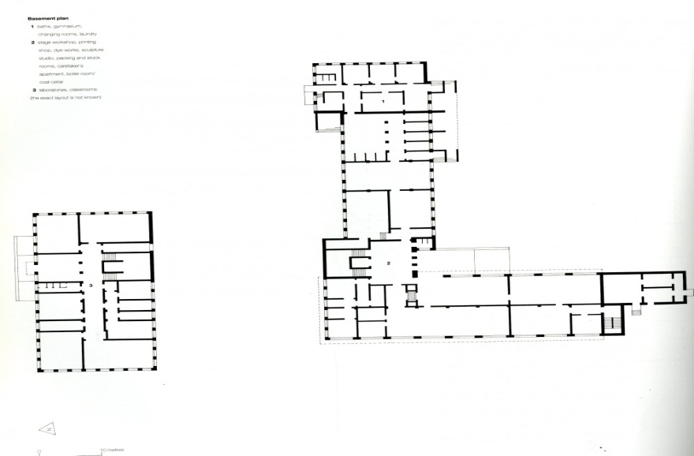
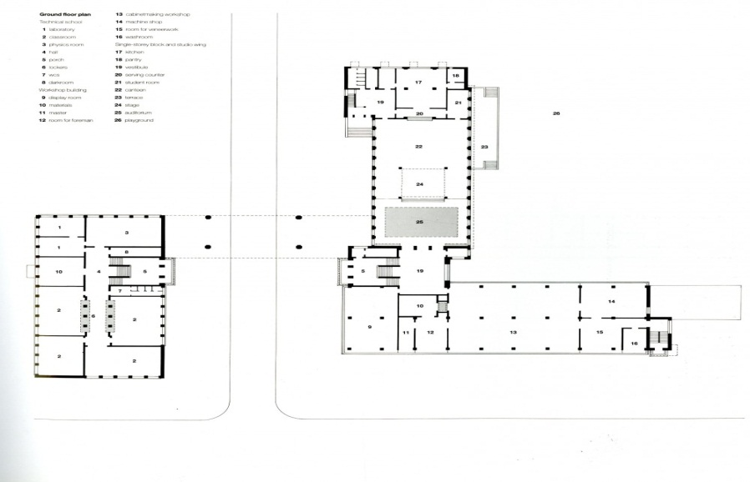
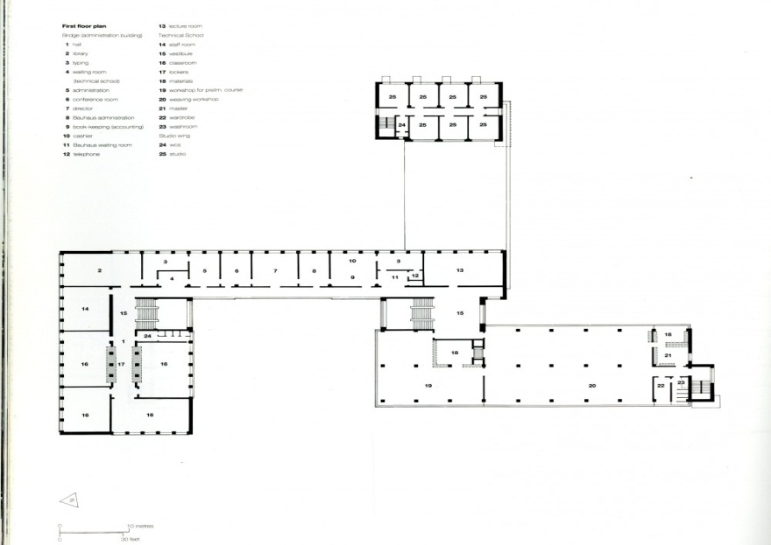
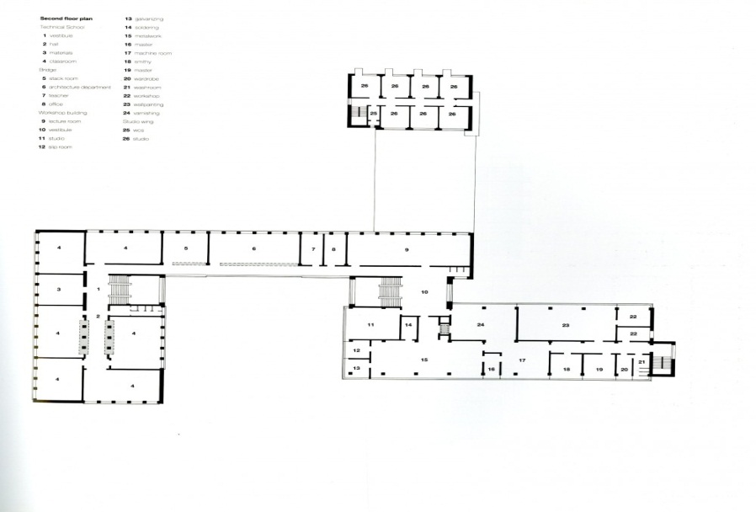
PLAN
BASEMENT PLAN GROUND FLOOR PLAN
FIRST FLOOR PLAN SECOND FLOOR PLAN

Slide 20
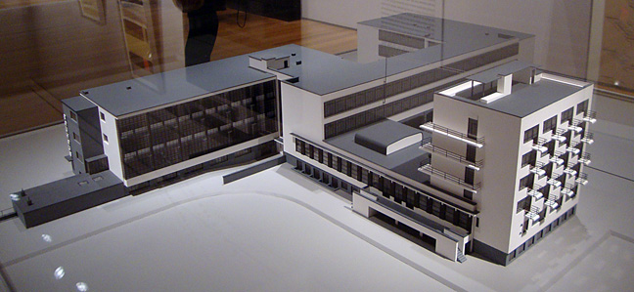
MODEL OF BAUHAUS
“MODEL (SCALE1:100)OF THE BAUHAUS DESAU,DESIGNED BY WALTER GROPIUS,MODEL REALIZED ARTIST UNKNOWN 1999 (AFTER BUILDING OF 1925-6) ,WOOD,PLEXI GLASS,PASTE BOARD ADHESIVE, 53 9/16 BY 1/8 BY 12 5/8 INCHES,STIFTUNG BAUHAS DESSAU

Slide 21
CONCEPT OF BAUHAUS
AFTER THE WORLD WAR,THE DEFEATED GERMANY WAS SEEKING A SOLUTION TO THE CRISIS OF VALUES IN WHICH HE WAS IMMERSED.INTELLECTUALS BELIEVED THAT THE POLITICAL IRRATIONALISM HAD LED TO VIOLENCE,SHOULD BE IMPOSED NOW CRITICAL RATIONALISM,ABLE TO RESOLVE SOCIAL CONTRADICATIONS.
GROPIUS WAS DEEPLY INVOLVED IN THESE APPROACHES,THEIR GREAT SHOW OF ARCHITECTURAL RATIONALISM WOULD BE THE UNIQUE BAUHAUS BUILDING IN WHICH ARE GROUPED THE CHARACTERISTICS OF MODERN MOVEMENT; RATIONALLY ARTICULATED PURE VOLUMES(FUNCTIONALISM),INNOVATIVE USE OF MATERIALS SUCH AS CURTAIN WALL GLASS FACADES,HORIZONTAL WINDOWS,NO DECORATION,OVERALL DESIGN OF ALL ELEMENTS AND,ABOVE ALL,A CONCEPTION OF SPACE DOMINATED BY THE INTERPLAY BETWEEN INSIDE AND OUTSIDE THROUGH THE GLASS WALL.
THESE PRINCIPLES WERE ACCEPTED AND WERE CONSOLIDATED RAPIDLY INTERNATIONALLY WITH HOME WORKERS WHO MIES VAN DER ROHE,PAST DIRECTOR OF THE BAUHAUS, RAISED NEAR STUTTGART IN THE WEISSENHOF ESTATE.

Slide 22
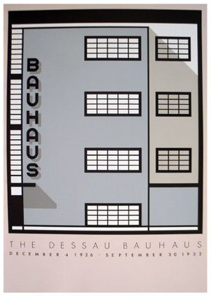
ELEVATIONS

Slide 23
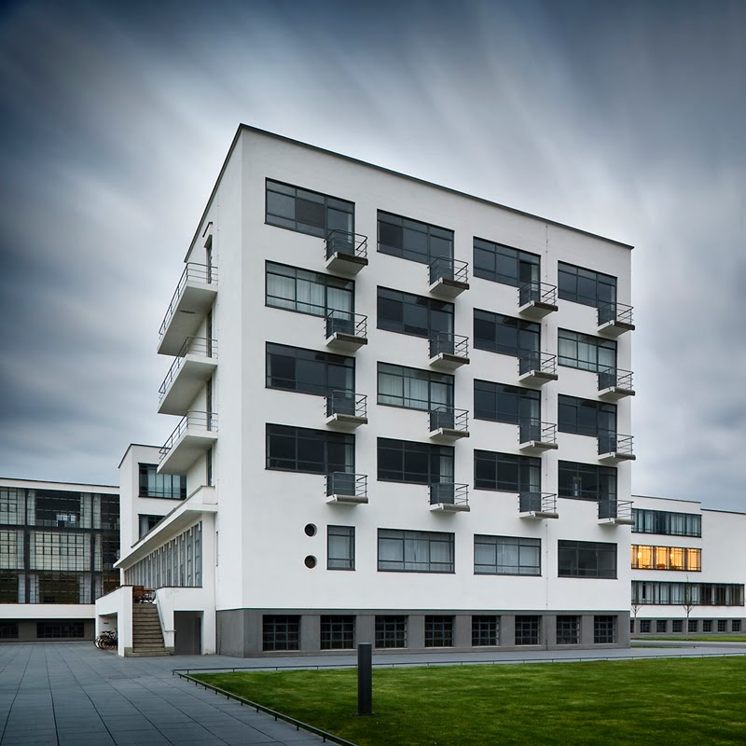
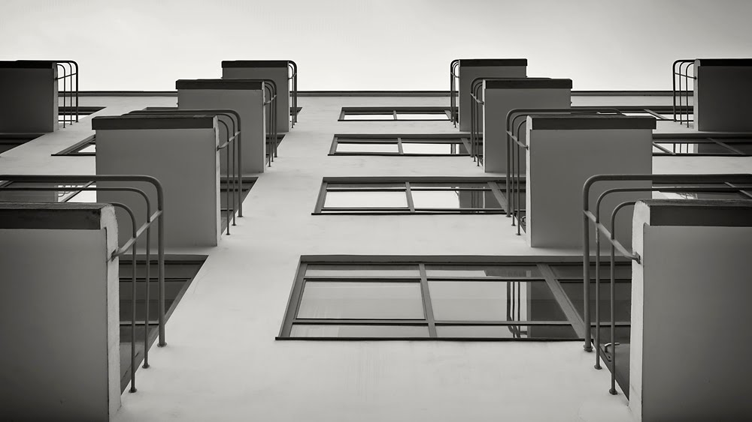
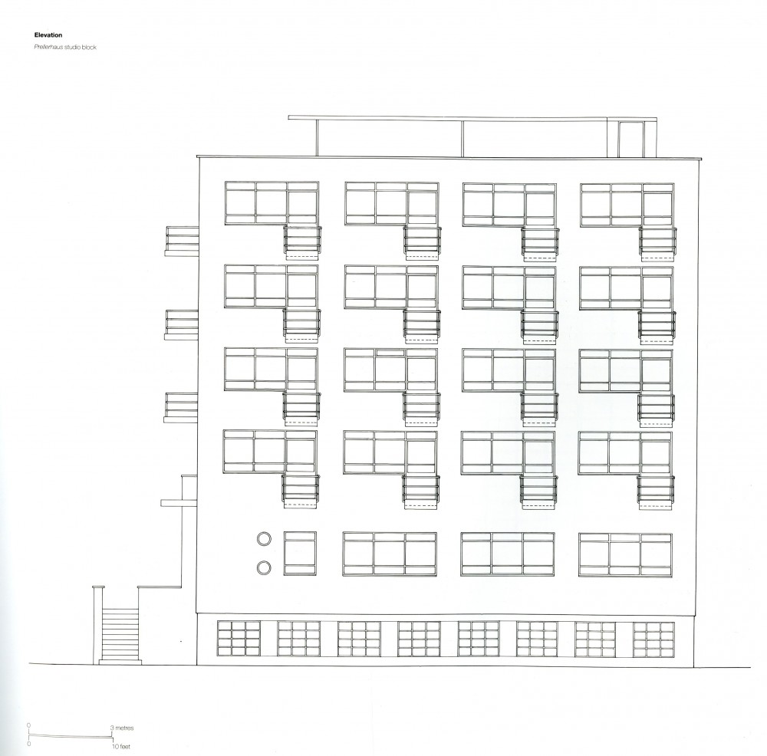
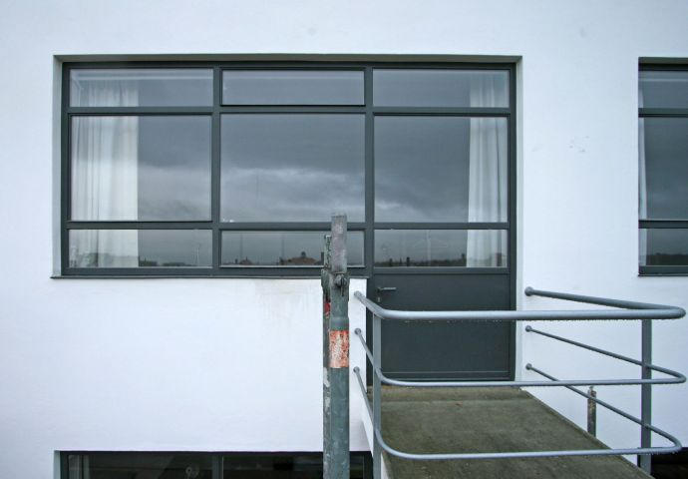
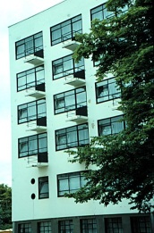
CANTILEVERED BALCONIES,BAUHAUS

Slide 24
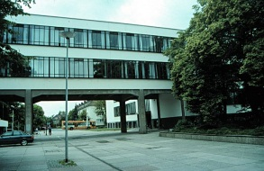
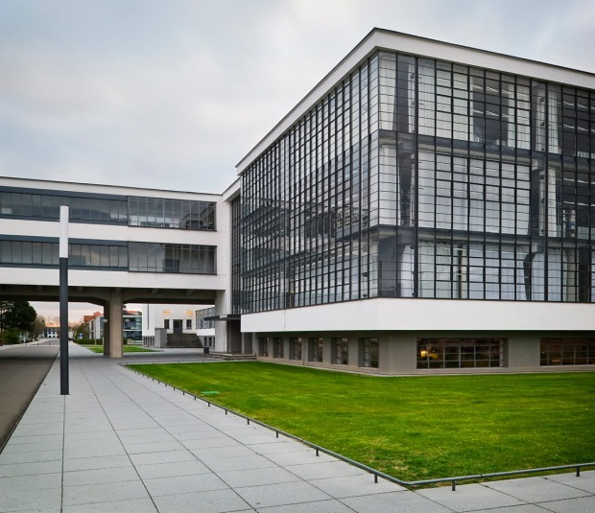
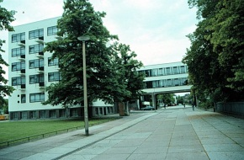
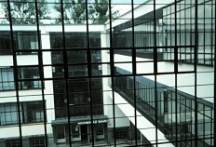
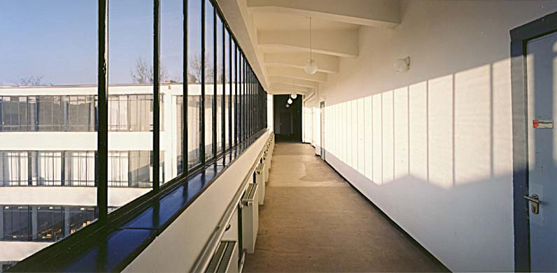
ADMINISTRATION WING OVER THE STREET,CONNECTING THE SCHOOL DIVISIONS

Slide 25
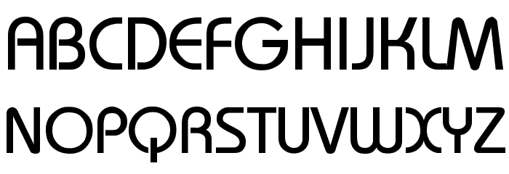
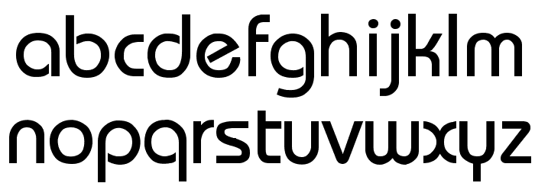
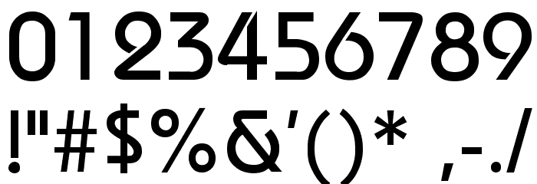
BAUHAUS 93 FONT
FOR OTHERS,THE BAUHAUS IS A TYPE OF FONT OR AN ARCHITECTURAL DESIGN STYLE….IT IS THE INTENTION OF THIS PAPER TO DRAW A HISTORICAL CONNECTION TO TECHNOLOGY EDUCATION AND THE PEDAGOGY…… WALTER GROPIUS FUNCTIONED THROUGHOUT THE LIFE OF THE BAUHAUS.

Slide 26
CHARACTER OF WORKS
SIMPLE GEOMETRY,OFTEN RECTANGULAR
USE OF MODERN MATERIALS LIKE STEEL AND GLASS
SMOOTH SURFACES
PRIMARY COLORS
LINEAR AND HORIZONTAL ELEMENTS

Slide 27
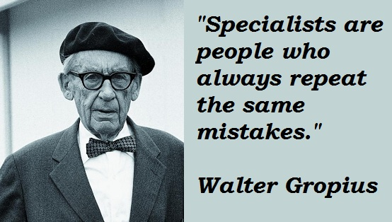
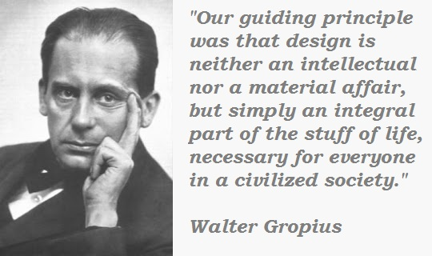
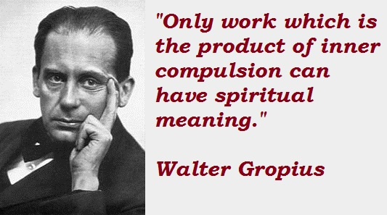
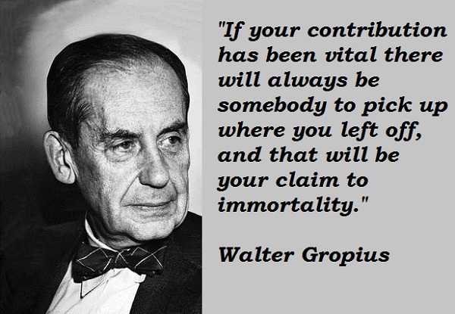
WALTER GROPIUS QUOTES

Slide 28
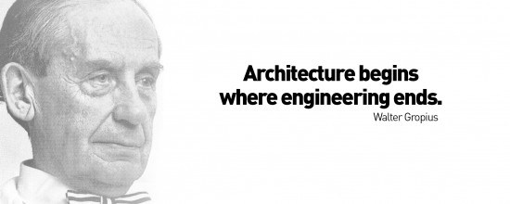
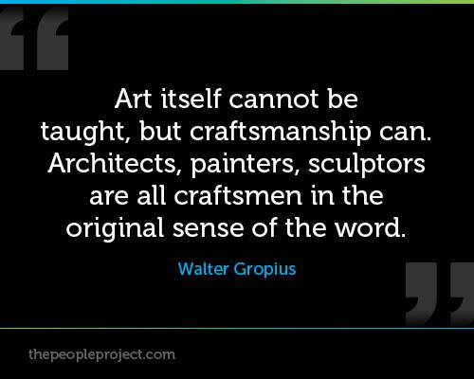
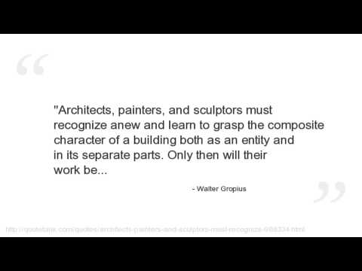

Slide 29
CONCLUSION
GROPIUS IS RECOGNIZED AS ONE OF THE FOUR PIONEERS OF MODERN ARCHITECTURE.THE OTERS BEING MIES VAN DER ROHE.FRANK LYOD WRIGHT AND LE-CORBUSIER.
GROPIUS WAS FUNCTIONLIST MOST OF HIS BUILDINGS IN GERMANY,ENGLAND AND AMERICA ARE CONSTRUCTED THAT AIM TO BE LOGICAL INTERPRETATION OF PURPOSE FOR INSTANCE VALLAGE SCHOOL,HARVARD GRADUATE CENTER.
GROPIUS WAS QUICK TO SEE THE ADVANTAGES OF ECONOMY IN THE BUILDINGS.
GROPIUS WAS EXPREIMENTED IN HIS PROJECTS.

Slide 30
BEING AN EDUCATOR HIS NATURE MADE HIM READY TO LISTEN TO OTHERS AND GIVE THEM THEIR FULL DUE.HE WAS ALWAYS READY TO CONSULT AND LEARN FROM OTHERS.
GROPIUS WAS A CLASSICIST AS HIS MOST BEAUTIFUL BUILDINGS PROVE e.g.:HOUSES BUILT IN BAUHAUS.
ALMOST ALL HIS BUILDINGS HAVE A SLIGHT HORIZONTAL EMPHASIS-BALANCED BY VERTICALS TOGETHER WITH THE RECTANGULAR WINDOWS MOVING TOWARDS SQUARES AND LARGE AREAS OF PLAN WALLS ALWAYS WELL-PROPORIONED CREE A FEELING OF CLASSIC REPOSE AND SIMPLICITY.
ALMOST ALL THE BUILDINGS HAVE FLAT ROOFS.IT WAS NOT ONLY AESTHETICALLY THAT HE LIKED THE FLAT ROOF-HE ALSO REALIZED ITS FUNCTIONAL ADVANTAGE IN FREEDOM OF PLANNING.

